Slide 1
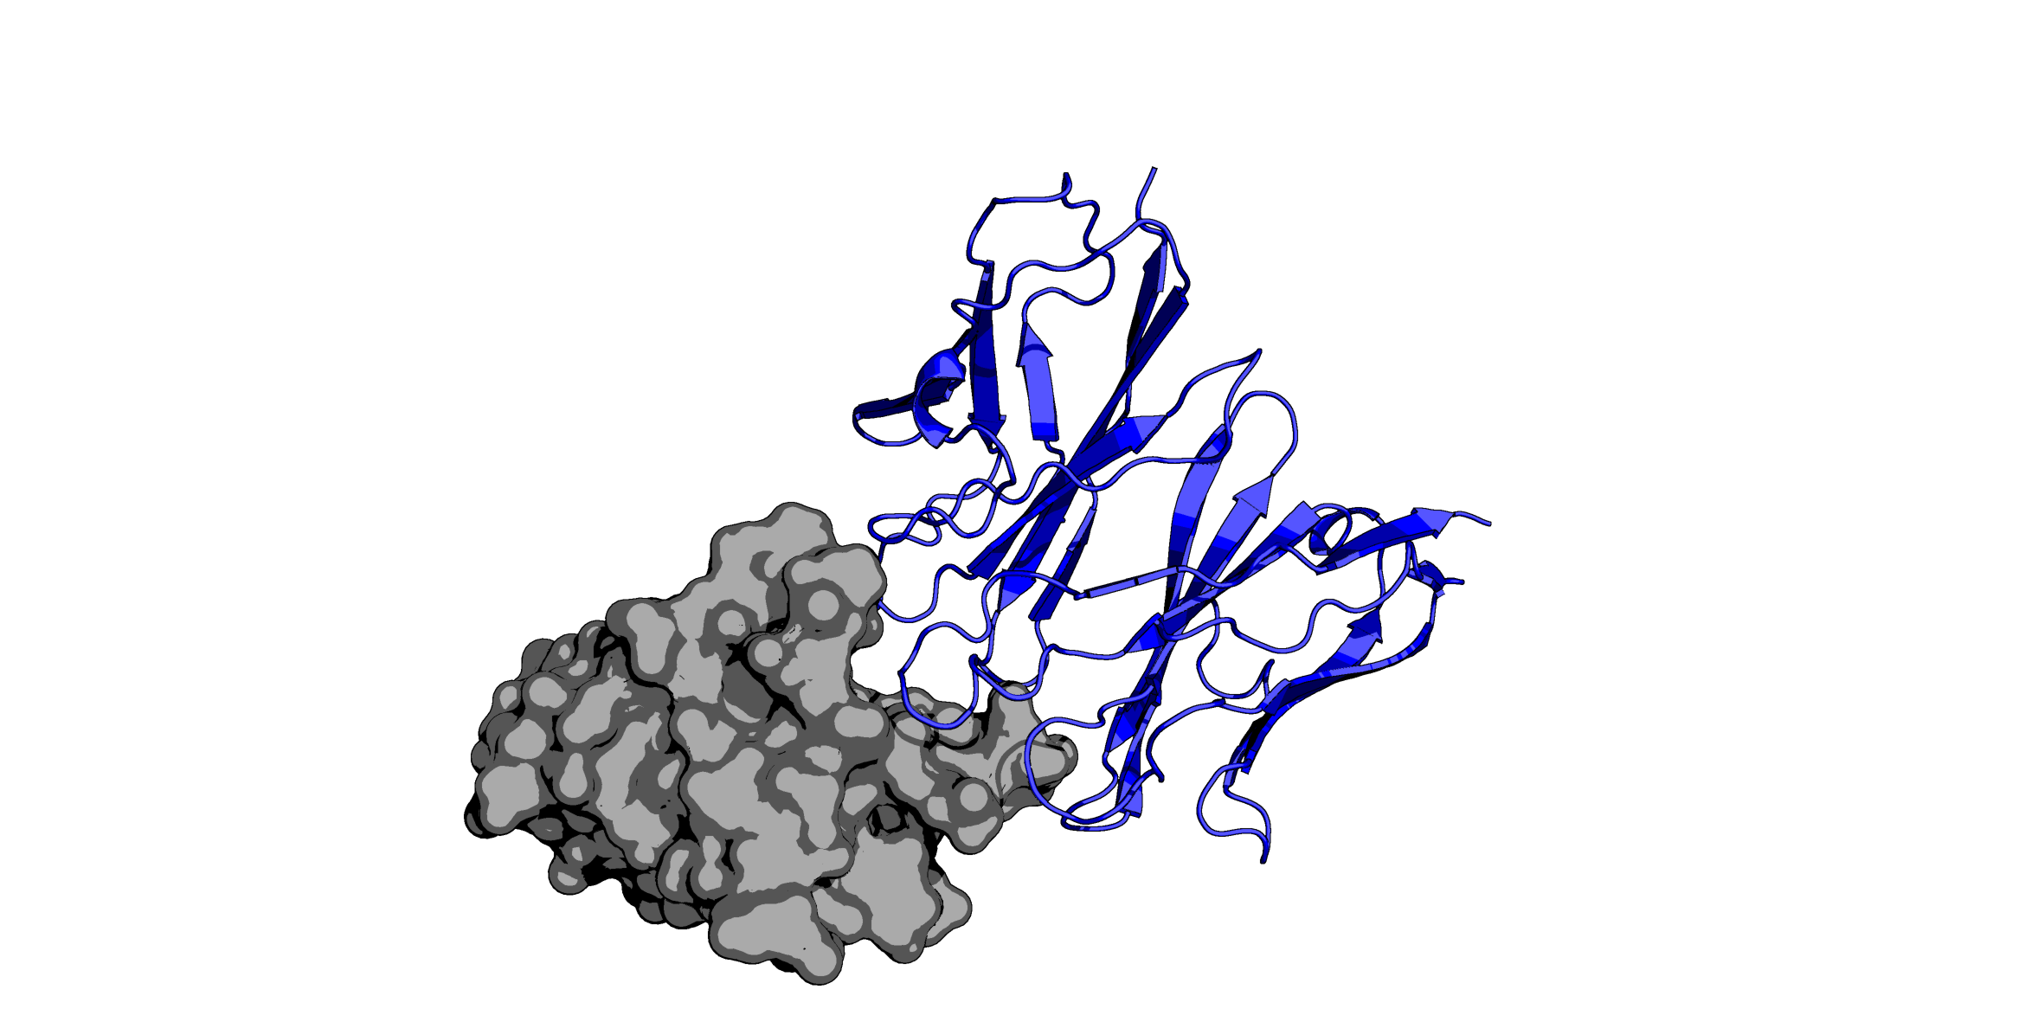
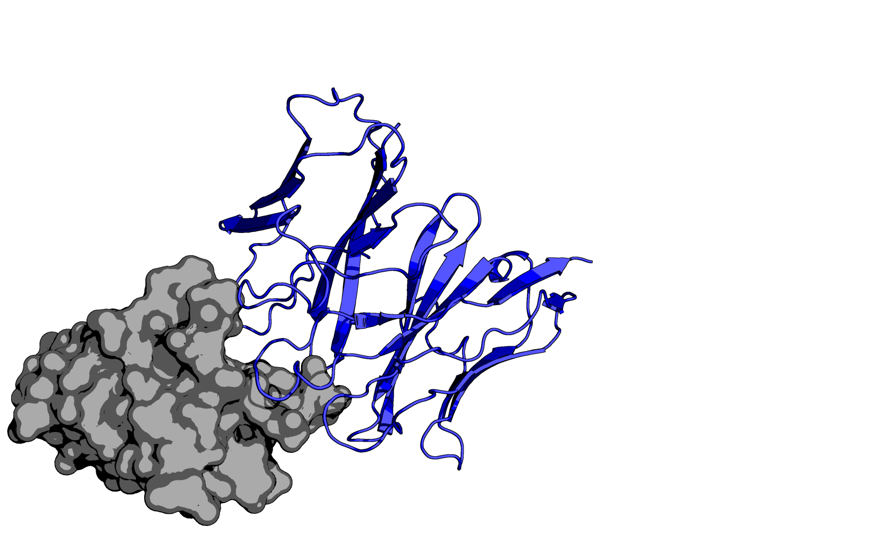
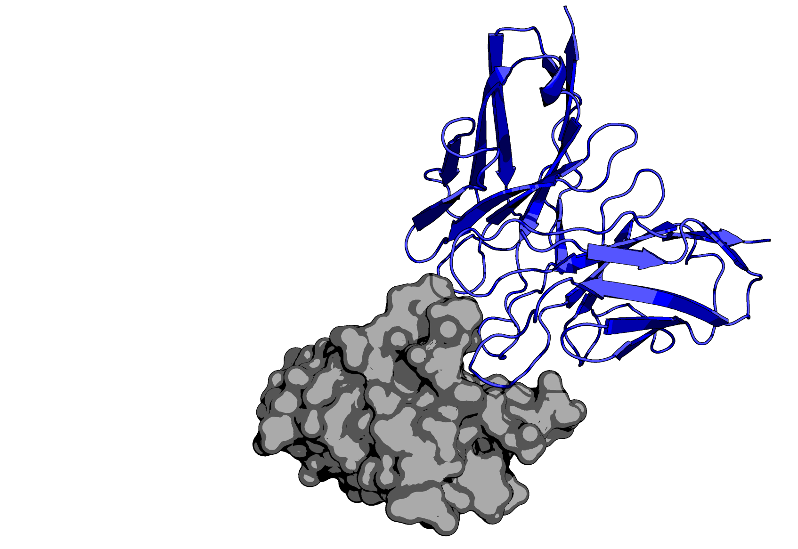
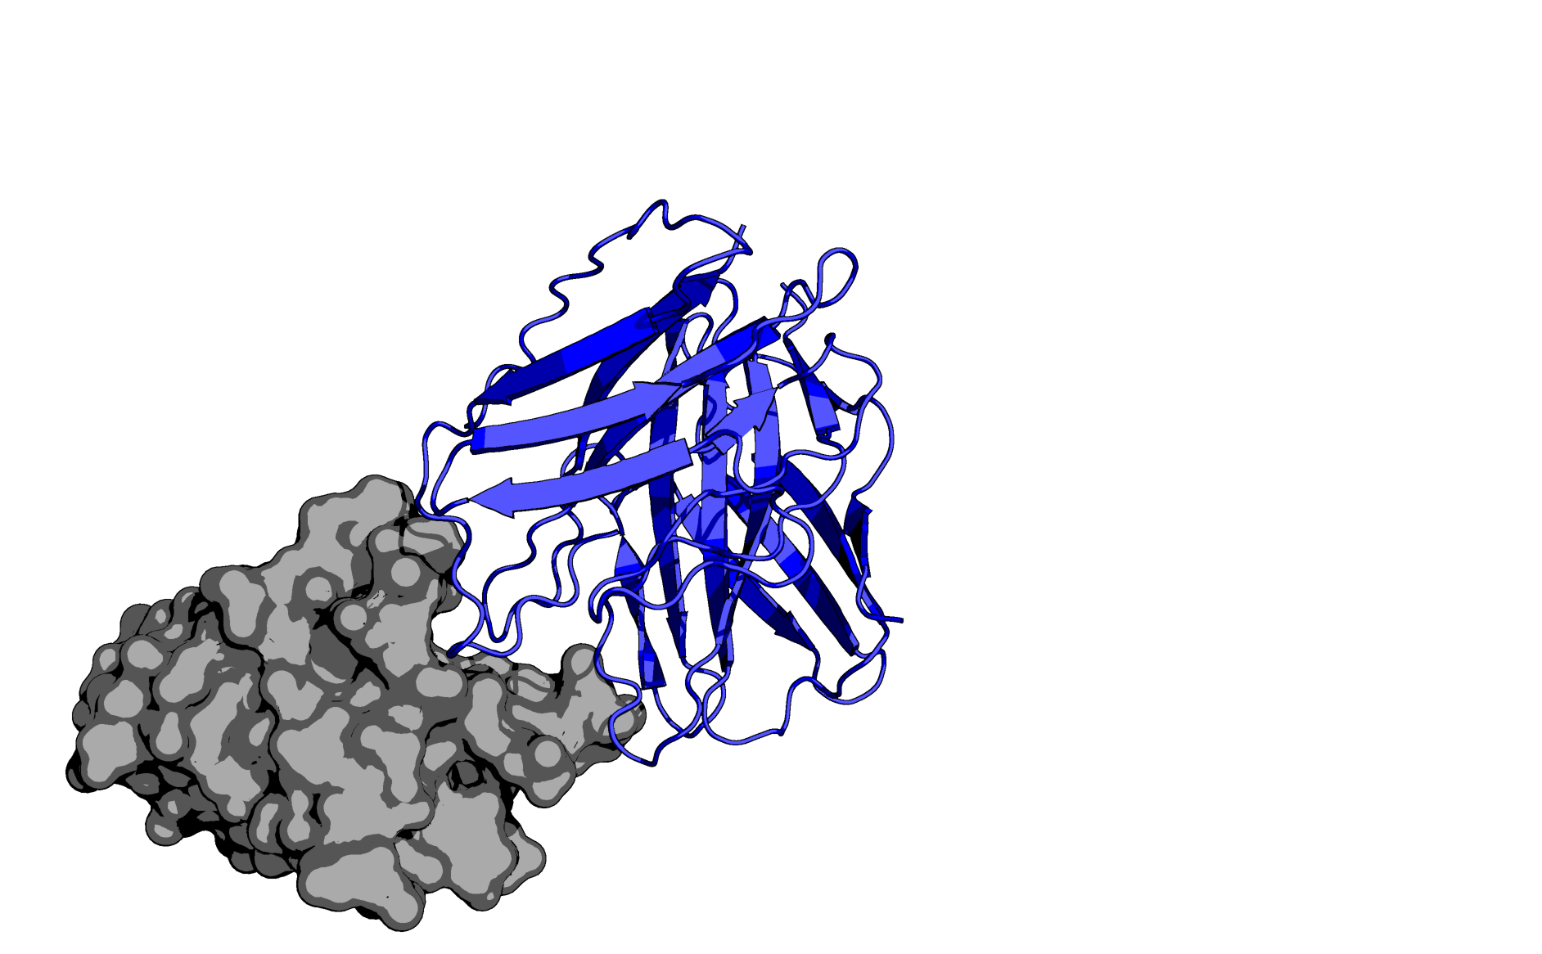
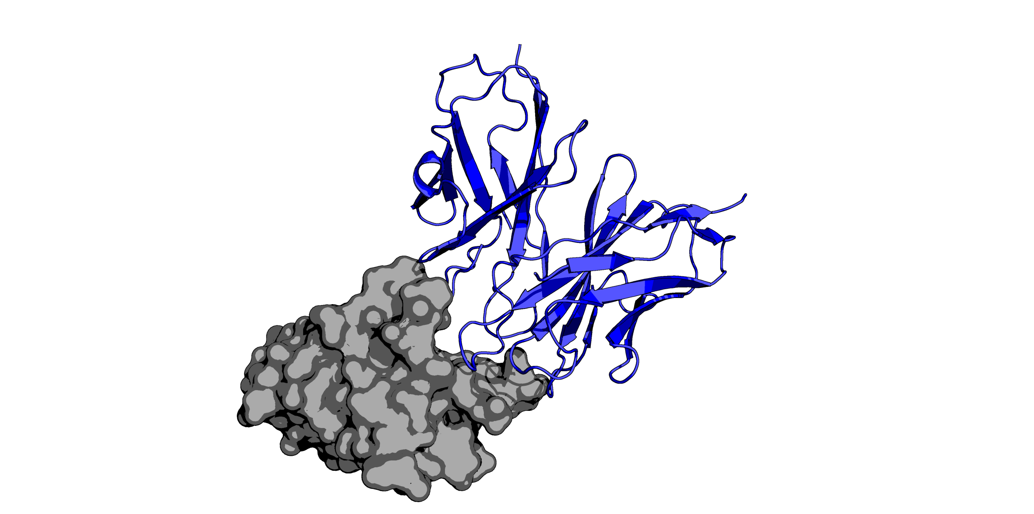
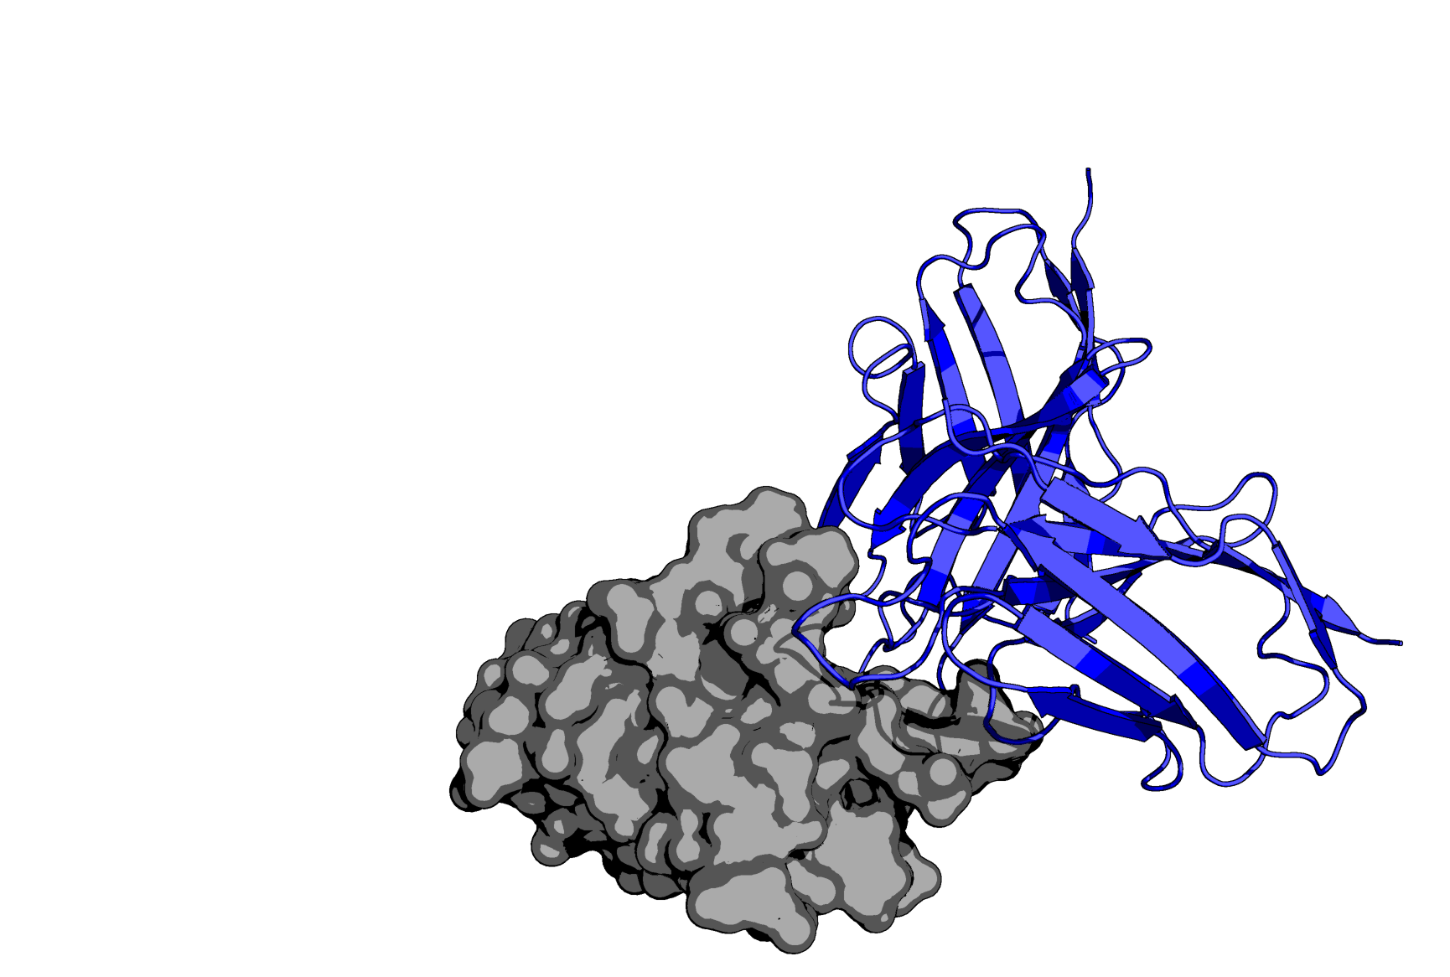
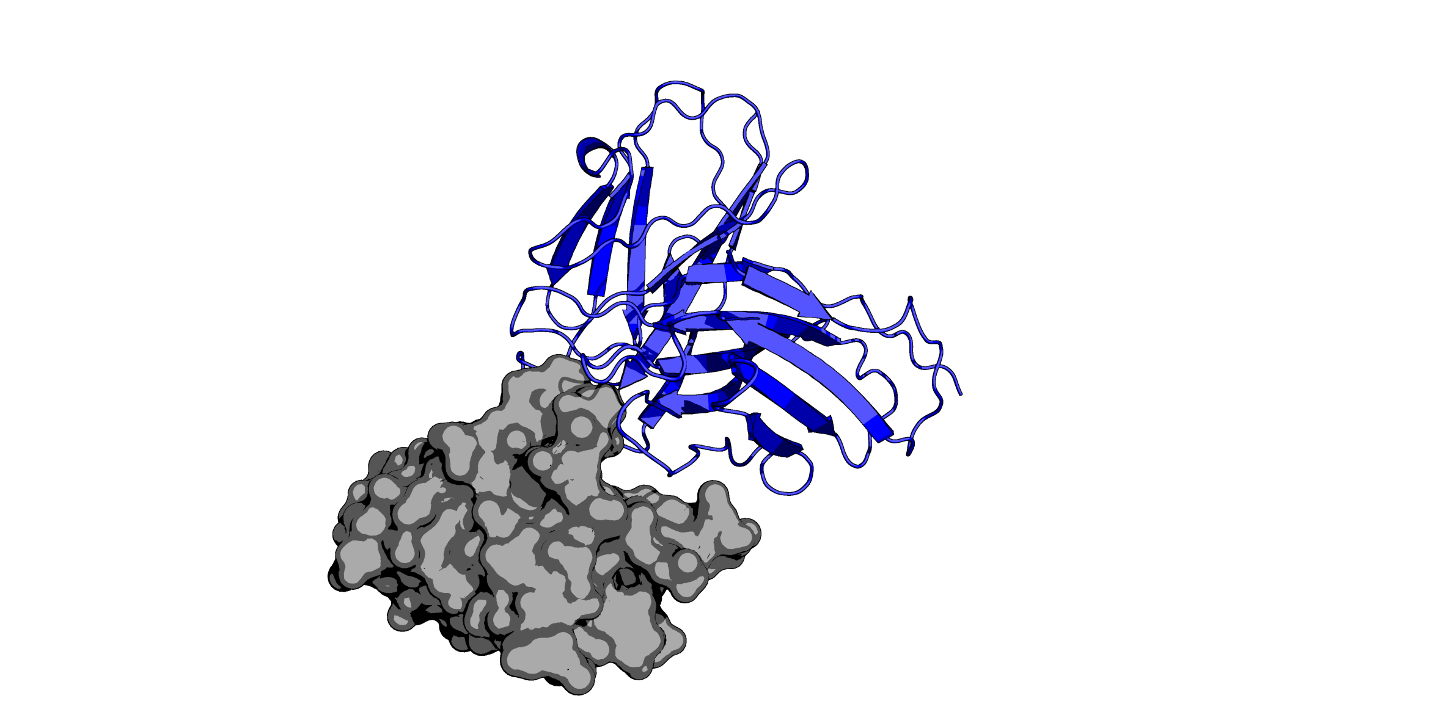
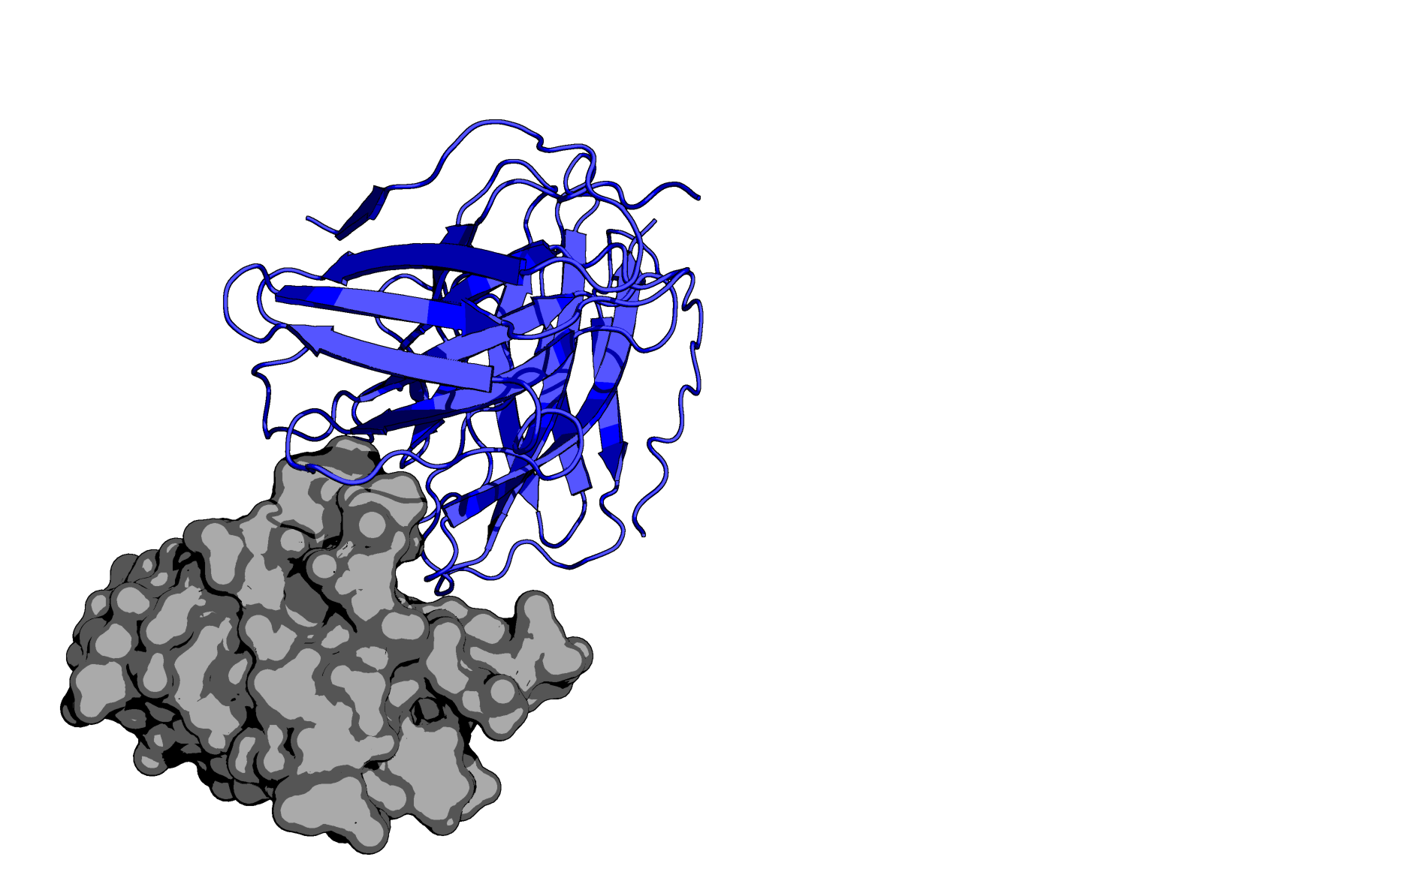
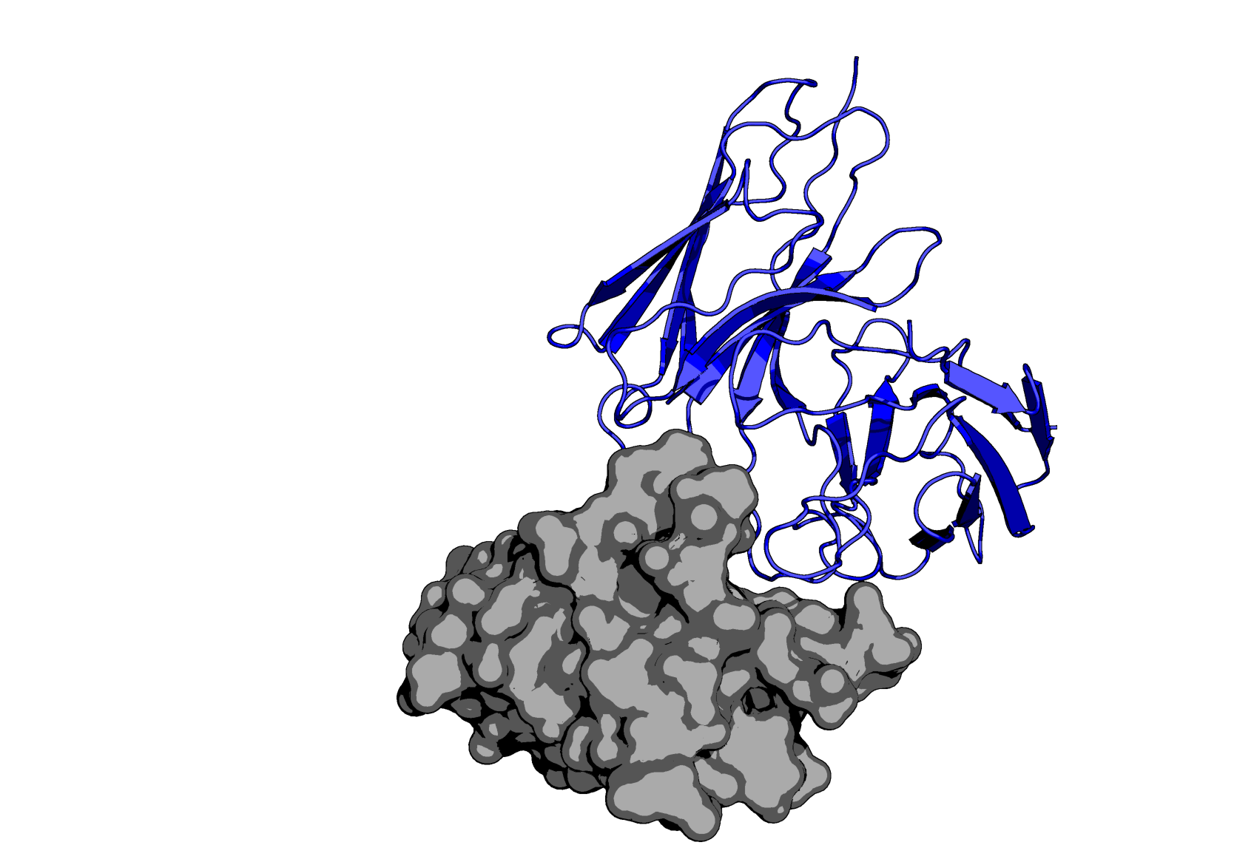
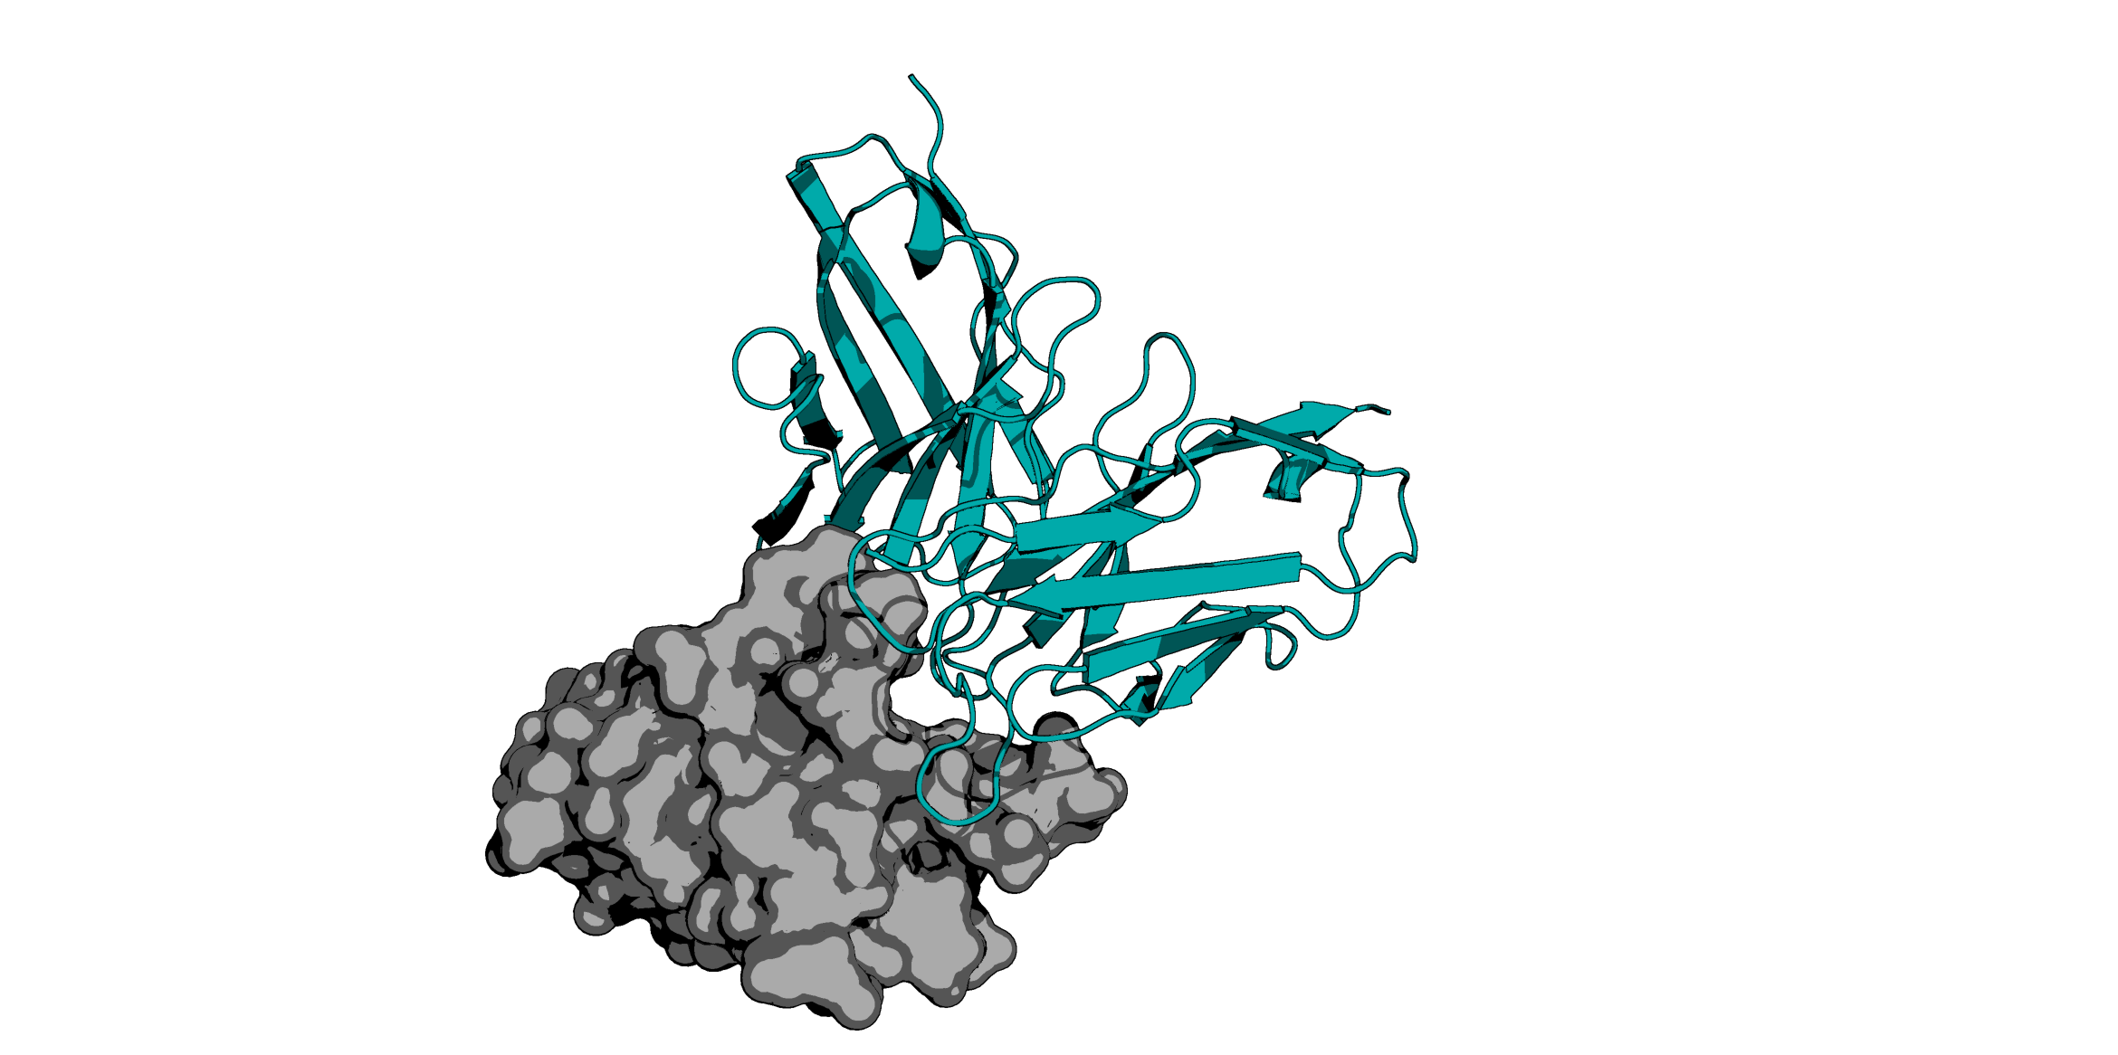
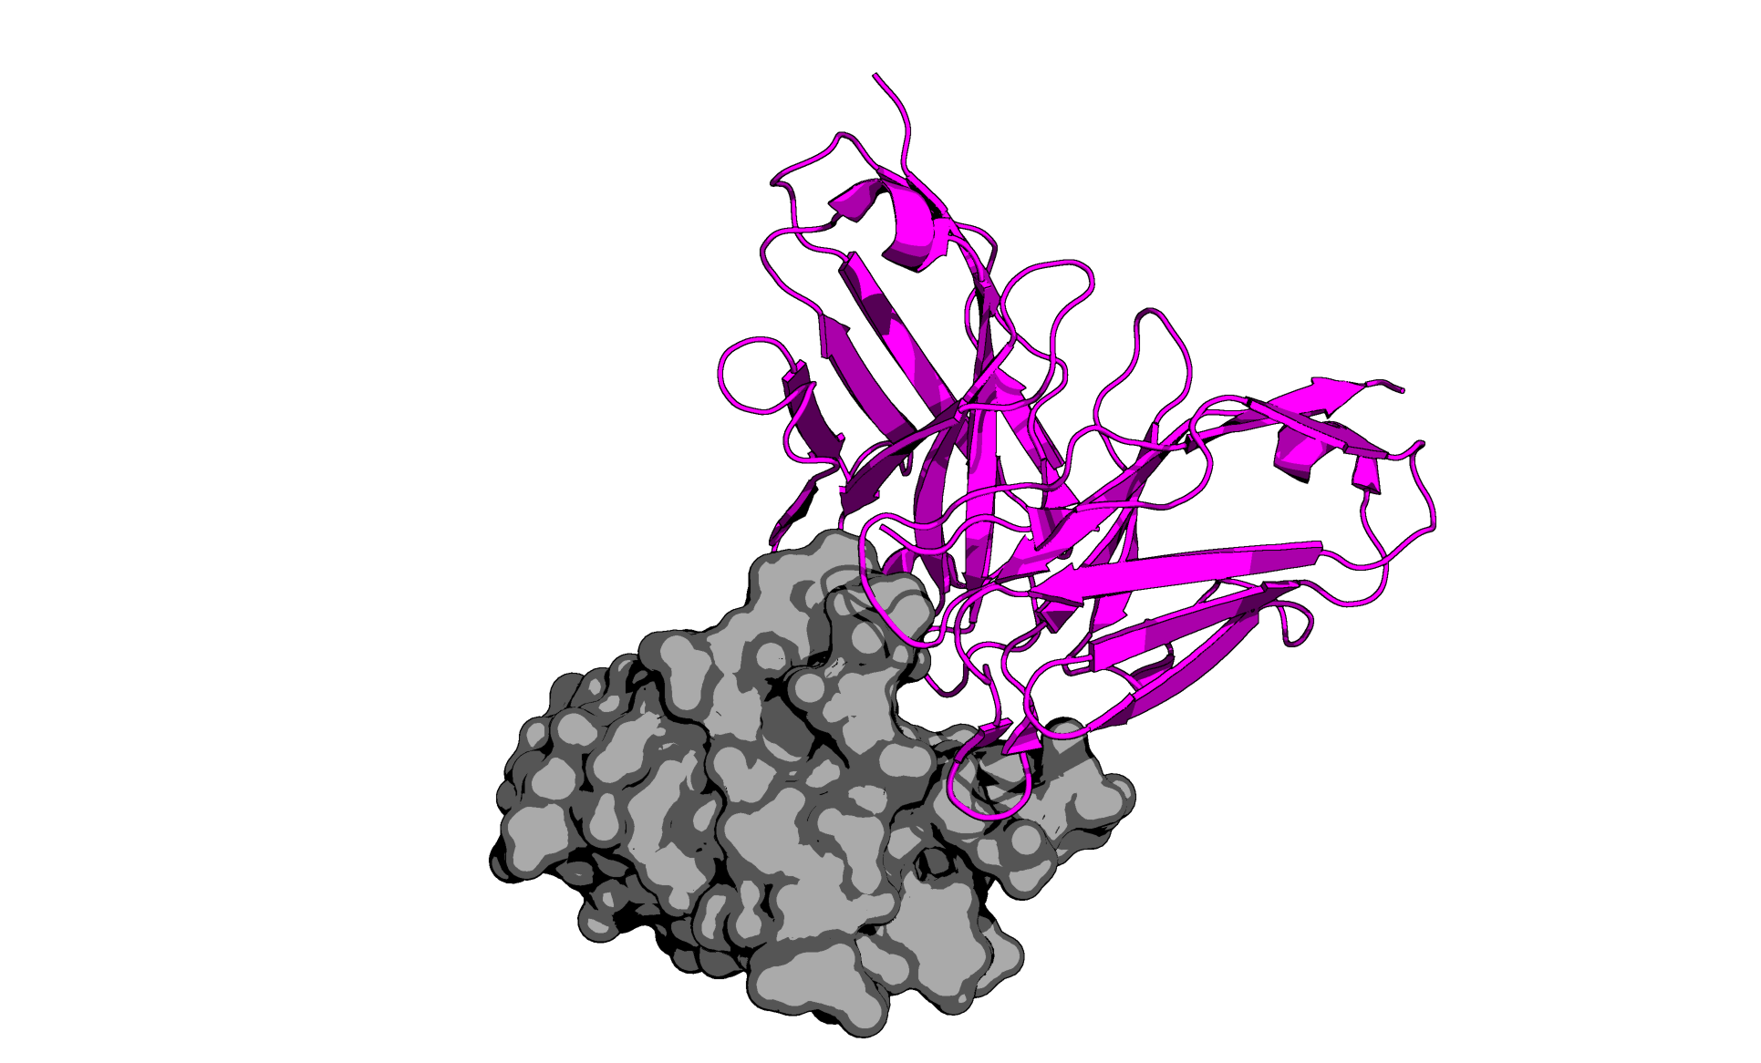
TUPPD1-001
TUPPD1-002
TUPPD1-003
Predicted
Predicted
Predicted
TUPPD1-004
TUPPD1-005
TUPPD1-006
Predicted
Predicted
Predicted
TUPPD1-007
TUPPD1-008
TUPPD1-009
Predicted
Predicted
Predicted
Pembrolizumab
Pembrolizumab
Predicted
PDB: 5JXE

Slide 2
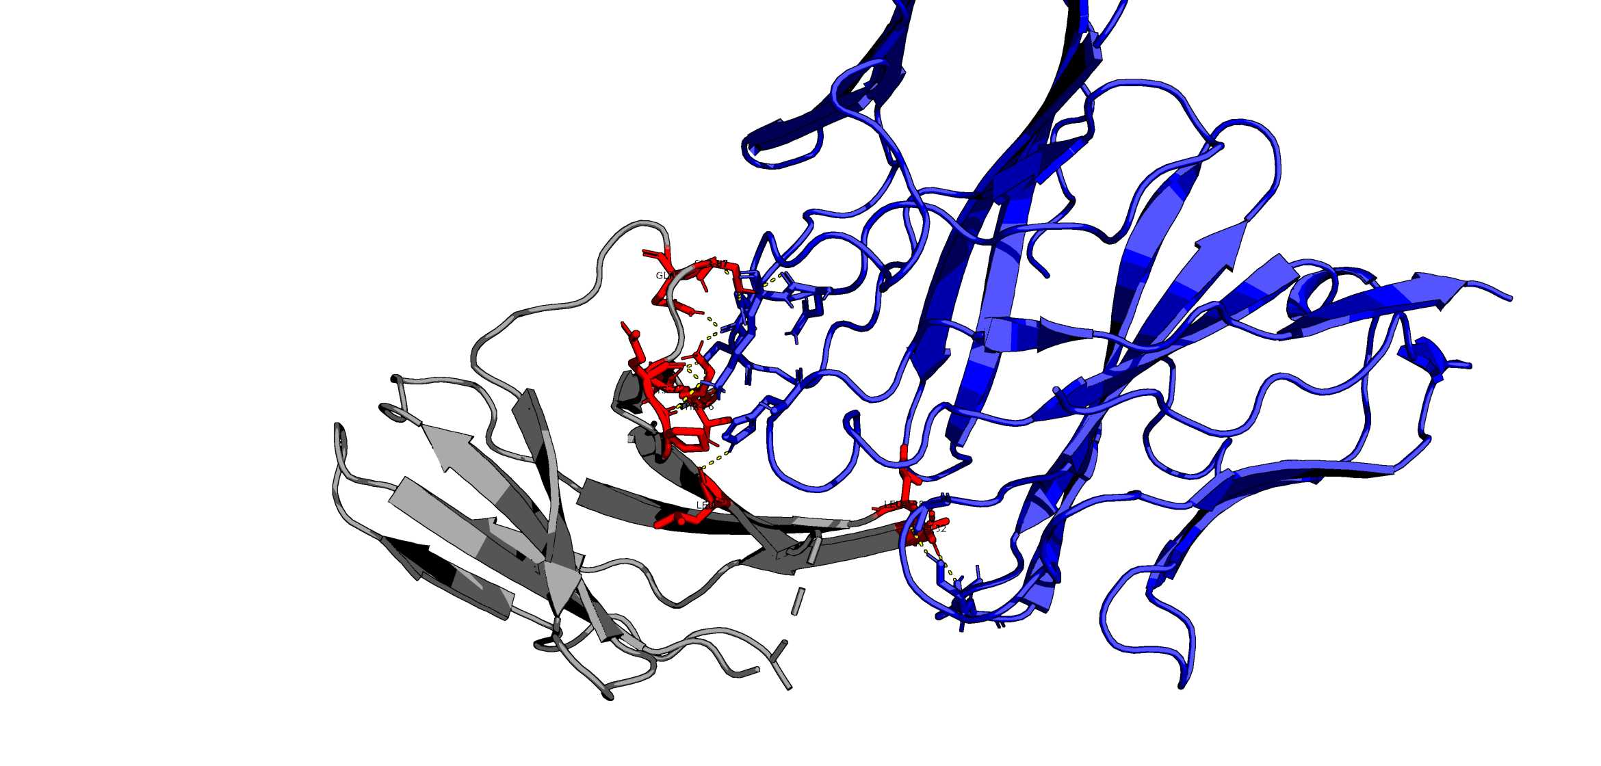
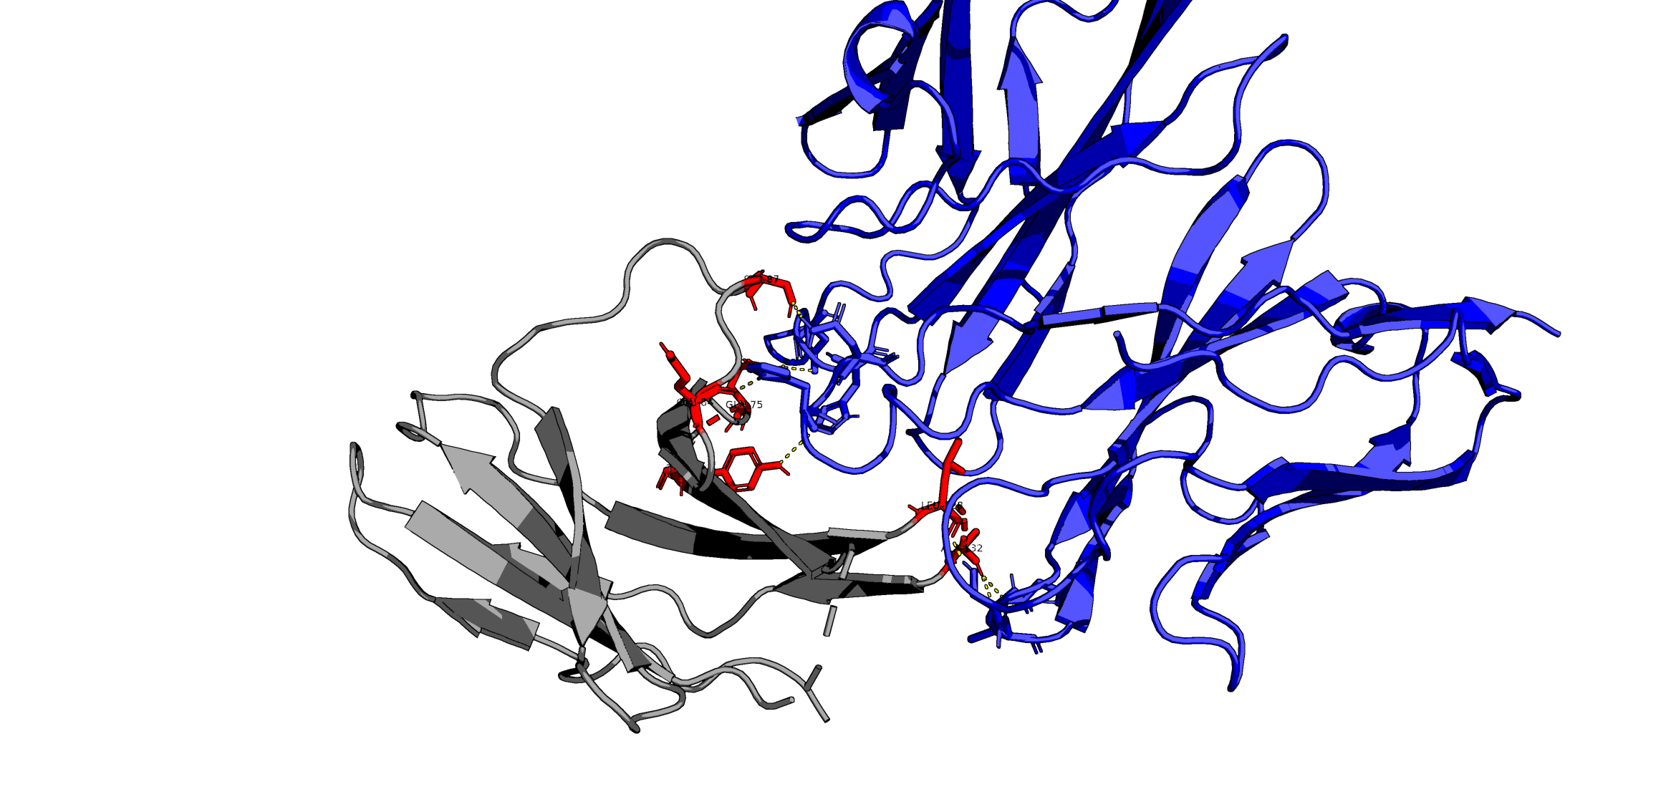
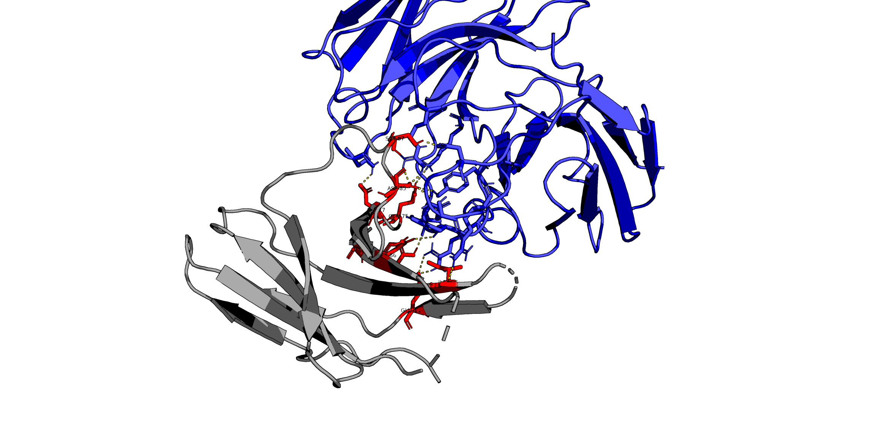
TUPPD1-001
GLN88
SER87
LYS78
THR76
LEU65
LEU128
ALA132
Predicted
TUPPD1-002
SER87
GLU84
GLN75
TYR68
LEU128
ALA132
Predicted
TUPPD1-009
SER87
ASP77
ASP85
GLN75
TYR68
ASN66
ILE126
GLU136
Predicted

Slide 3
TUPPD1-001
GLN88
SER87
LYS78
THR76
LEU65
LEU128
ALA132
Predicted
TUPPD1-002
SER87
GLU84
GLN75
TYR68
LEU128
ALA132
Predicted
TUPPD1-009
SER87
ASP77
ASP85
GLN75
TYR68
ASN66
ILE126
GLU136
Predicted

